Slide 1

Performance Testing PROJECT
DIVRAJ M

Slide 2



Modules
SCENARIO
TIMESHEET
Create Employee
Create Admin
Create Time Sheet
PIM
Create Employee
Modify Employee
ADMIN
Create Employee
Create Admin

Slide 3

What HTTP status codes have I faced in this project?
200
OK – Success
302
Found – Temporary Redirect
403
Forbidden – Access Denied
404
Not Found – Resource Missing
422
Unprocessable Entity – Validation Failed

Slide 4
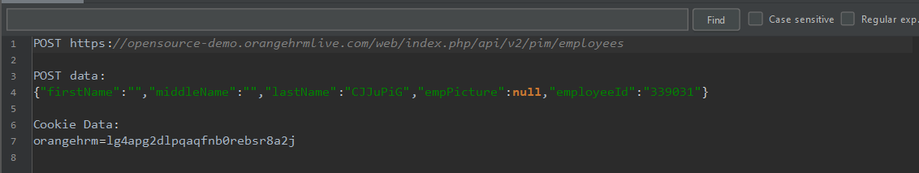


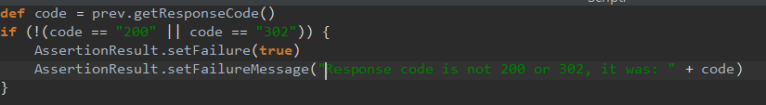
How I Resolve My Error?
{"error":{"status":"422","message":"Invalid Parameter","data":{"invalidParamKeys":["firstName"]}}}
422
404

Slide 5


Key Learnings from This JMeter Project
Implementing Pacing Time Effectively
Using Setup Thread Group to Initialize Test Parameters
Handling Dynamic Values in Requests
Status Code Handling & Debugging
Filtered out noise by excluding debug samplers from analysis
Generating and Analyzing Performance Reports

Slide 6
Aggerate Report – PIM

Slide 7
Aggerate Report – ADMIN

Slide 8
Aggerate Report – TIME SHEET

Slide 9
DIVIDER SLIDE TITLE
Key Performance to Improvements in pim,admin and time sheet
SUBTITLE GOES HERE
Optimize Backend Logic in Add PIM & Admin Modules -Solution: optimize database queries, reduce unnecessary joins
Reduce Payload & Minimize API Overhead -Solution: Compress payloads, eliminate unnecessary fields in request, reduce HTTP header
Notes:
© Copyright Showeet.com – Free PowerPoint Templates

Slide 10

THANK YOU

